Slide 1

Dhaka International University
Course Name : Software Development Management
Project Name : Data Drift
Presented by
Turbo Gear
Sumaiya Rahman Ava (03)
AL Noman Robin (19)
MD. Johir Khan Tonmoy(36)
DATE : 18/04/2026

Slide 2
Session Outline
TAR-3
Introduction Literature Review Problem Statement & Motivation ‌Objective & Possible outcome
Proposed Methodology ‌References

Slide 3
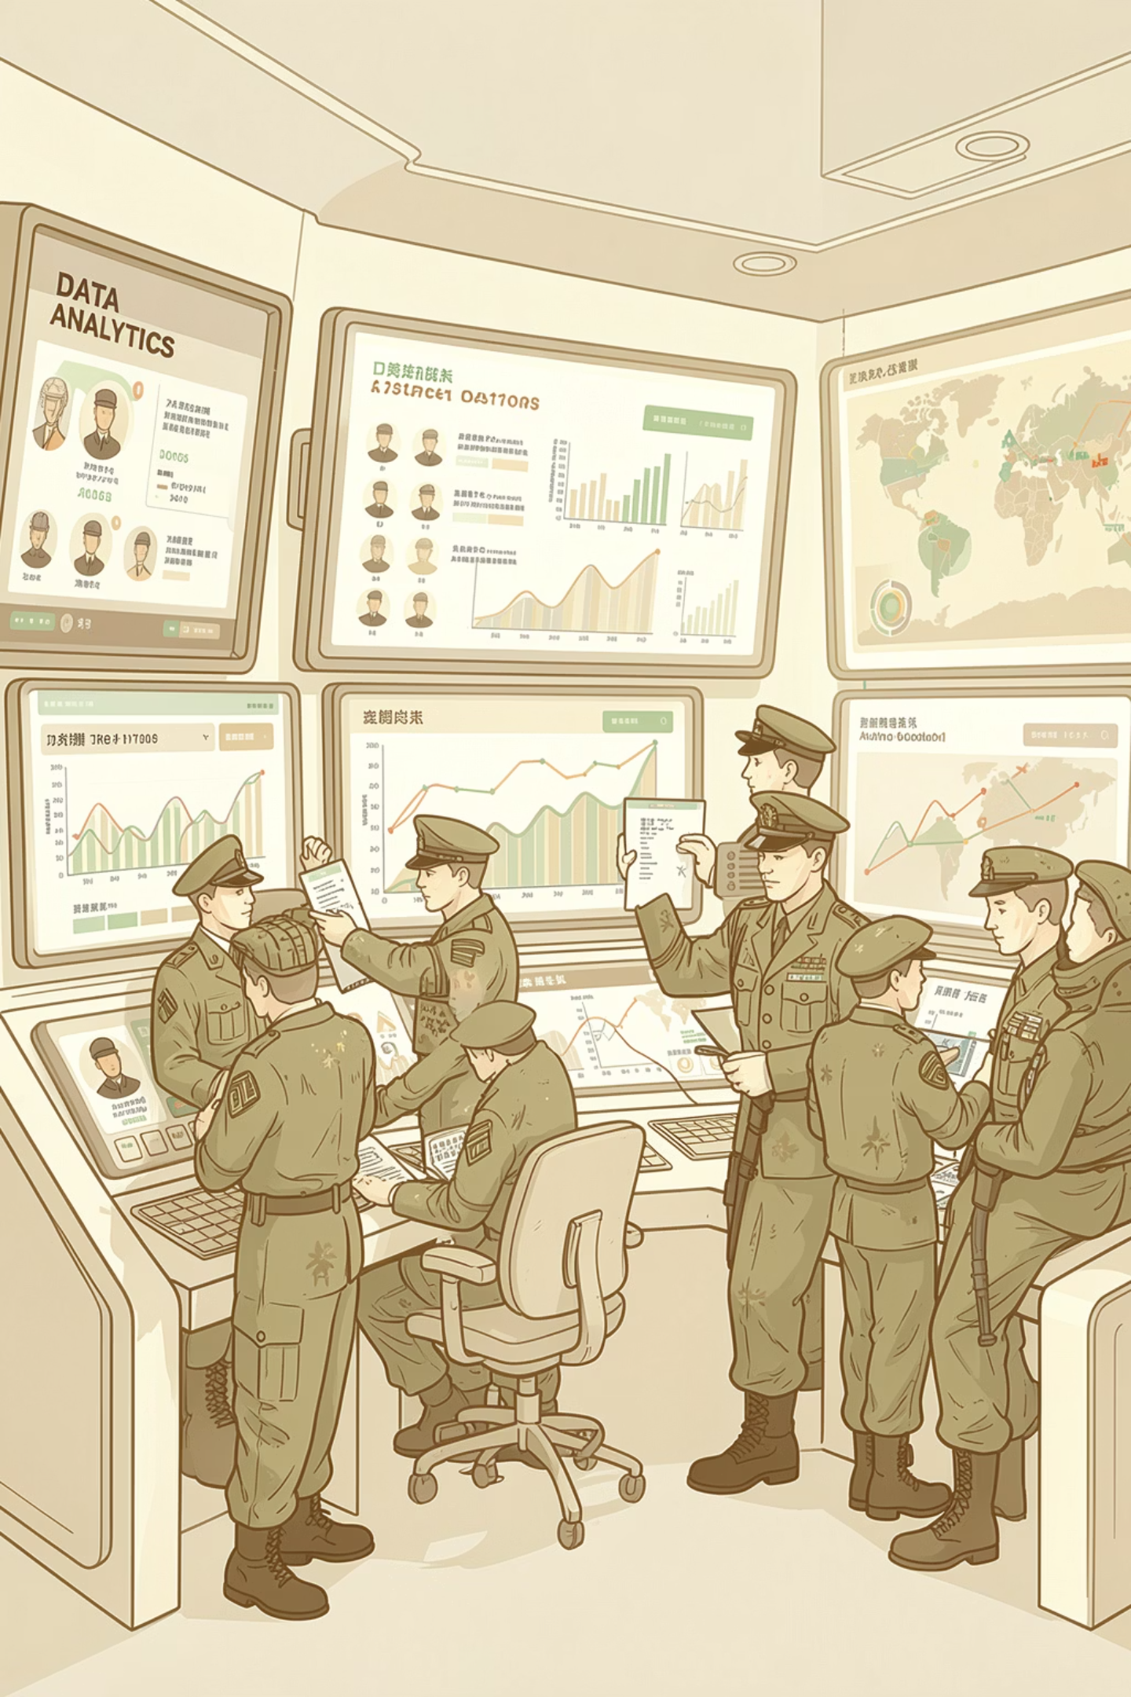
Introduction
Training Assessment Report(TAR) Platform
A secure, data-driven platform that evaluates performance, ranks people, and assigns tasks automatically—all in one centralized system for efficient operations.
0

Slide 4
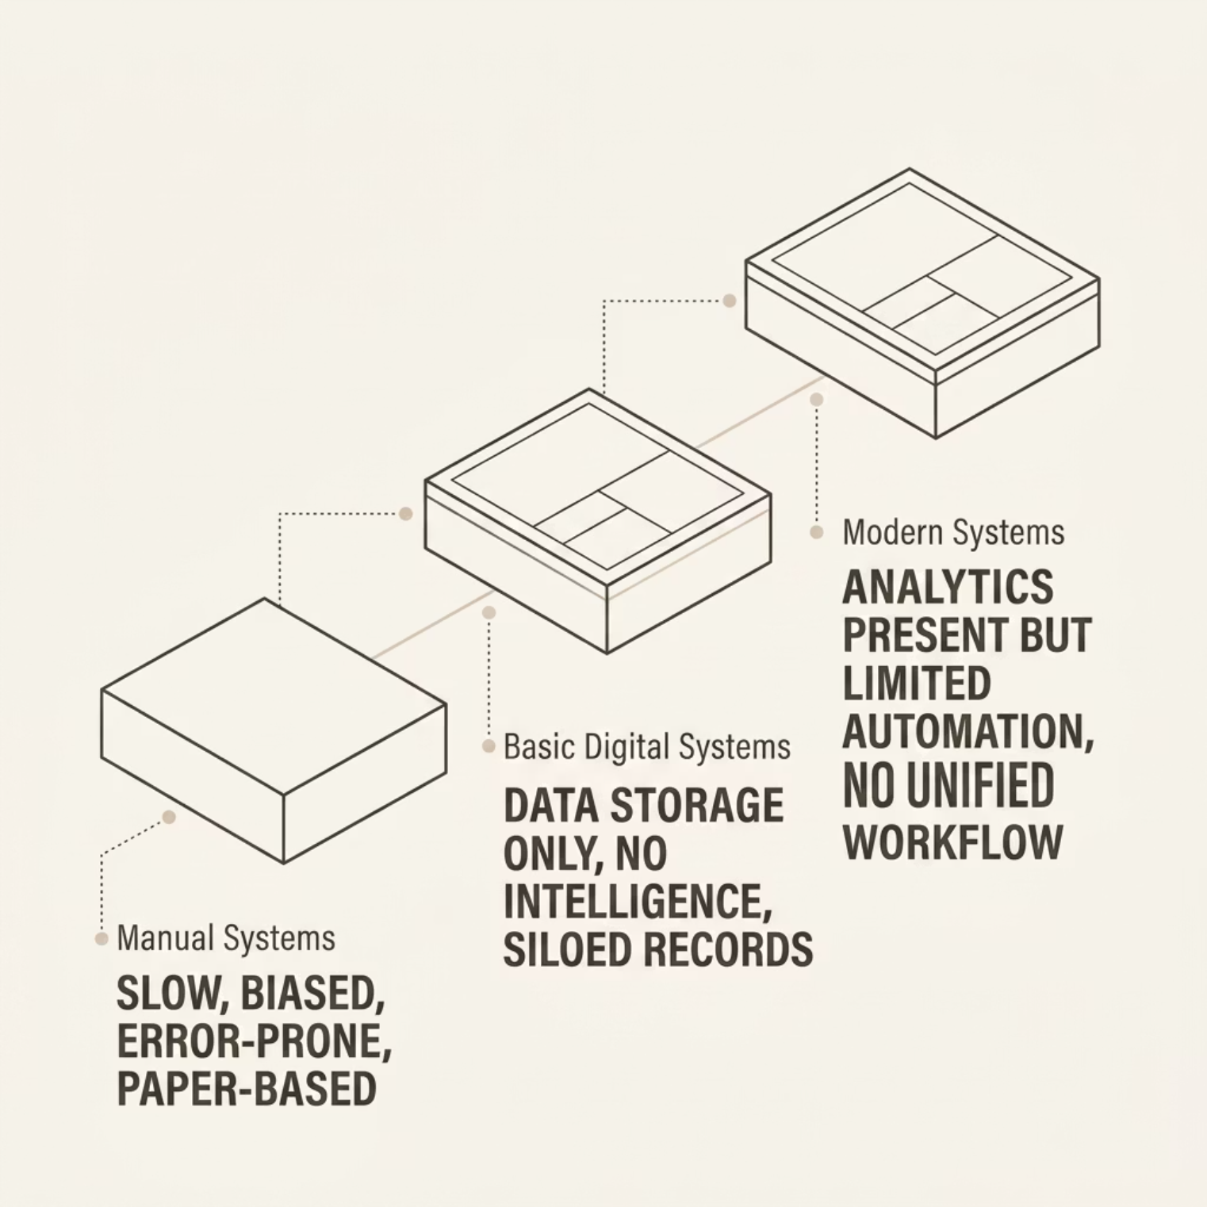


LITERATURE REVIEW
The Evolution of Personnel Systems
Personnel systems improved over time, but none combine evaluation, classification, and task assignment in one platform.
Research Gap: No unified system combining performance evaluation + personnel classification + smart task assignment.
1

Slide 5

PROBLEM STATEMENT
Why the Current Approach Falls Short
The Problem
The Motivation
Manual processes lead to slow, inconsistent decisions
Human bias and data-entry errors skew evaluations
Poor skill-to-task matching wastes personnel potential
No centralized data repository for cross-unit visibility
Automate repetitive evaluation workflows
Enable data-driven, objective decision-making
Improve operational efficiency and accuracy
Deliver real-time insights to commanders
2

Slide 6



OBJECTIVES & OUTCOMES
What We Set Out to Build — and What It Delivers
Core Objectives
Expected Outcomes
Performance-Based Ranking
40–50% Faster
Higher Accuracy
Objective scores from training, fitness, and discipline data
Task assignment speed
Reduced human error
Smart Task Assignment
Algorithm-driven matching of skills to mission requirements
Better Utilization
Real-Time Insights
Centralized Data Management
Optimal resource matching
Live analytics dashboard
Single source of truth across all units and roles
3

Slide 7





METHODOLOGY
System Architecture
API & Frontend
The TAR System follows a modular, scalable architecture. Each layer is independently maintainable, enabling rapid iteration and deployment across diverse operational environments.
Backend logic, scoring engine, React UI
Data Layer
Secure records and performance data
Core Analytics
TAR classification and task matching
Admin
Trainer
Full system control
Input & scoring
Commander
Viewer
Task requests
Read-only access
4

Slide 8

CORE LOGIC
How the TAR Engine Works
Performance Evaluation
Scores are computed across three weighted dimensions:
Training proficiency — course completion and skill assessments
Physical fitness — standardized test results
Discipline record — conduct and compliance history
TAR Classification
Smart Assignment: The system ingests personnel skills and task requirements, then outputs the best-fit candidate suggestion automatically.
TAR-1
TAR-2
TAR-3
High Performer
Medium
Basic
5

Slide 9

DATA FLOW & STRENGTHS
From Input to Assignment in Seconds
Compute Score
Submit Request
Suggest Candidate
Input Data
Assign TAR
The end-to-end workflow completes in under two seconds
from data entry to actionable assignment recommendation
with full audit logging at every step
Response Time
Uptime
Role Types
processing speed
Reliable, always-on availability
Granular, secure access control
6

Slide 10
CONCLUSION
Key Takeaways & The Road Ahead
What TAR Delivers
Future Scope
AI-based personalized recommendation engine
Predictive analytics for readiness forecasting
Real-time mobile tracking and notifications
Automated & Intelligent
Eliminates manual bias and delays
Accurate & Efficient
References
40–50% faster task assignment
TAR System Product Requirements Document
Decision Support Systems — Academic Research
Data-Driven Personnel Evaluation Frameworks
Real-World Ready
Scalable architecture for operational deployment
7

Slide 11

Any questions? If yes, Please submit them directly to your inner overthinking system.

